Slide 1

Is Twitter a credible source of information for important trends or topics in education ?
@Paresh Raut 8 Dec 2022
MSCA 31013 Big Data Platforms Final Project

Slide 2

Executive Summary
Data insights :
100 M+ tweets were extracted for the study but were filtered to 52 M+ tweets based on words selected to capture trend in education.
Majority of twitterers and Top twitterers are non-verified and do not belong to a credible organization, so all tweets should not be considered a reliable source of information.
Key Initiatives:
De-prioritize tweets from non-verified twitterers that don’t belong to an established organization in the Twitter algorithm, while prioritizing those of influential and credible twitterers determined by their influence score and background based on their profile information.
Add badges to tweets by credible twitterers so users know what information to trust.
Analyze Trending tweets by country or location to better understand if there is a correlation between education tweets and trends and progress in education.

Slide 3






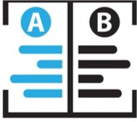
Methodology
Explore variables and remove or fill in Nulls/NAs
Tweets were grouped into
organizations like university,
news , etc.
Analyze top 50% of influential
twitterers and what organizations
they belong to
Analyze original tweets for
duplication vs.
uniqueness using
LSH text similarity analysis
Tweets related to trends in education were filtered
Analyze where twitterers are
who they are and
when they tweet
Verified users were
given Influence rating
based on formula
*check appendix for influence calculation and avg. influence.

Slide 4
Data Insights
• 100M+ Tweets extracted from the Twitter API from April 2022 to November 2022.
• 52.7M+ Twitterers talking about educational trends on Twitter.
• 11.7M+ non duplicate Twitter user id’s, which were categorized into organizations
Organization | Number of Twitterers
School | 1408
Government | 3080
Influencer | 46537
Other | 11679799
nonprofit organization | 26
Celebrity | 1815
University | 966
News | 22382
Country | Count
United States | 549531
United Kingdom | 73096
India | 46373
Kingdom of Saudi Arabia | 28523
Canada | 25197
verified 2%
non-verified 98%

Slide 5
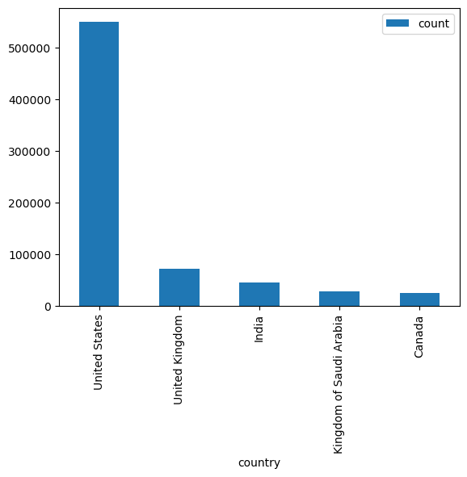
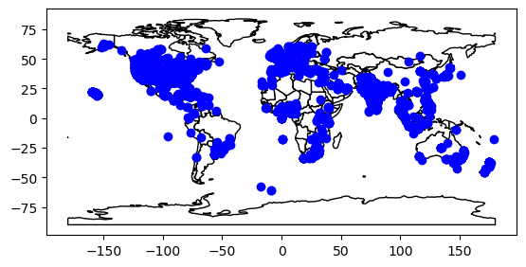
Geographical Distribution of Twitterers
Majority of tweets discussing topics related to trends in education were from the U.S., UK and India which align with the top countries with the most Twitter users.*
Fig 1: Geographical distribution of tweets discussing education trends
Fig 2: Count of tweets for highest tweeting nations

Slide 6
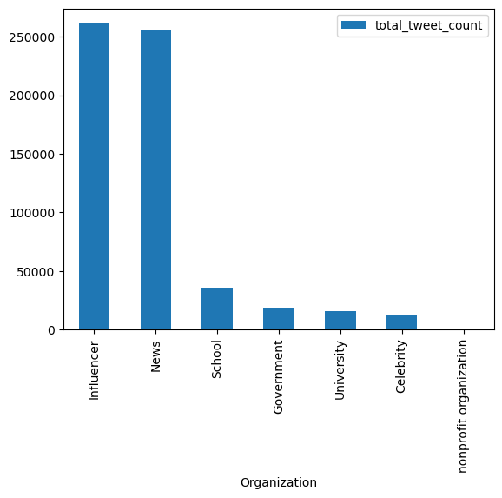
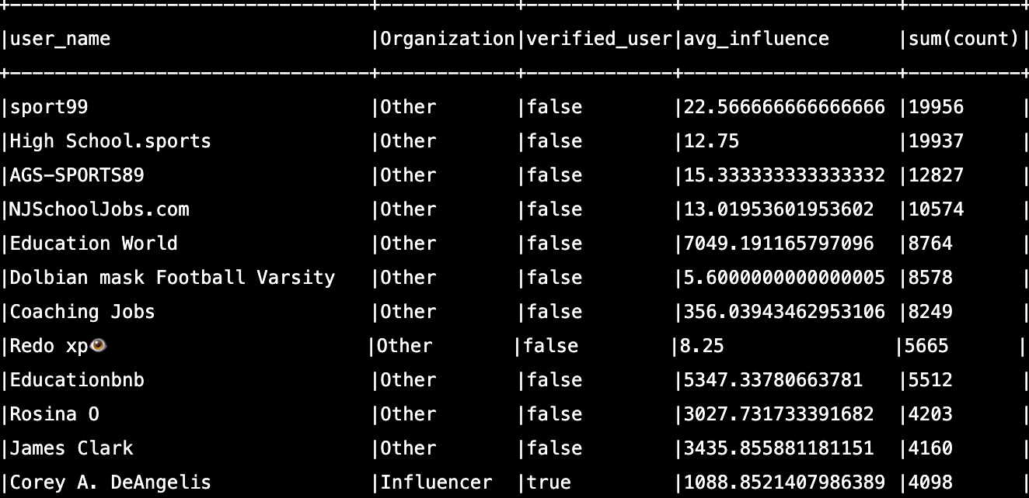
Top Influential Twitterers* By Original Tweet Count
The top influential twitterers by tweet count are all non-verified and belong to the “Other” category.
The “Other” category has the most tweets, but by organization/type -> “Influencer” has the most education tweets.
Note: dropped the “Other” Category from chart for visibility of the other organizations *Analysis done on Top 50% of twitterers based on average influence score

Slide 7
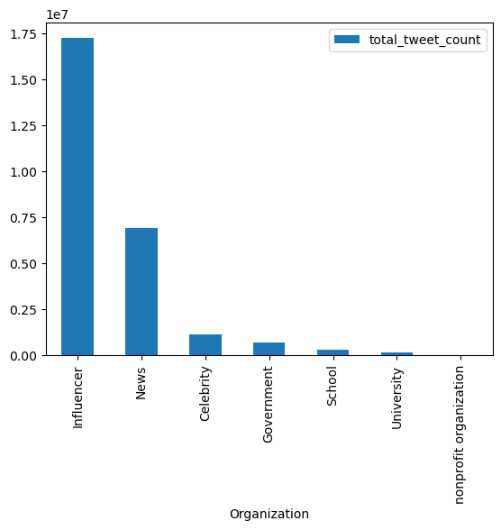
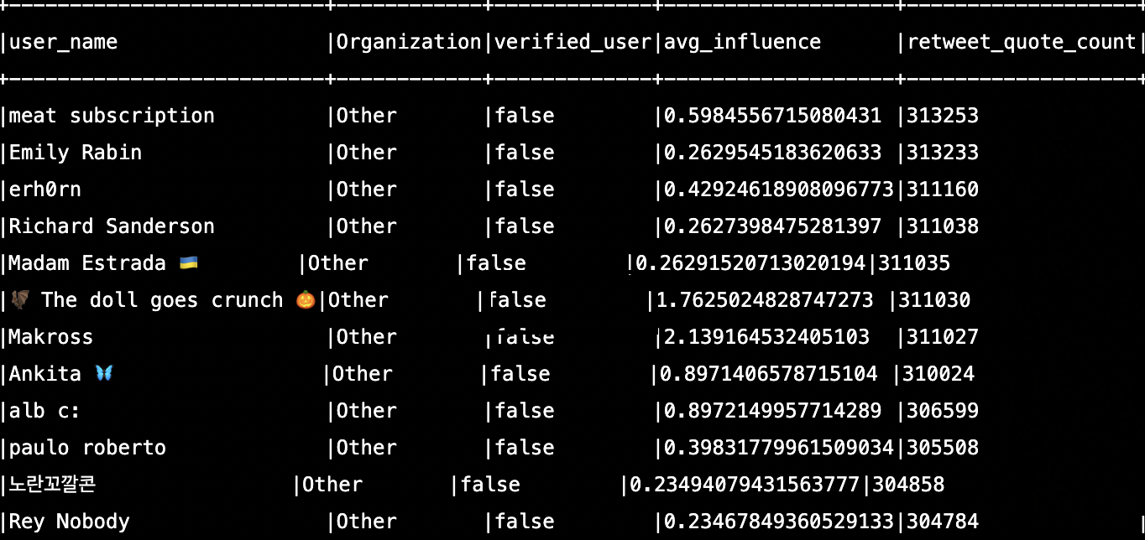
Top Influential Twitterers* By Retweet Count
The top influential twitterers by retweet count are all non-verified and belong to the “Other” category.
The “Other” category has the most retweets, but by organization/type -> “Influencers” have the most education retweets.
Note: dropped the “Other” Category from chart for visibility of the other organizations *Analysis done on Top 50% of twitterers based on average influence score

Slide 8
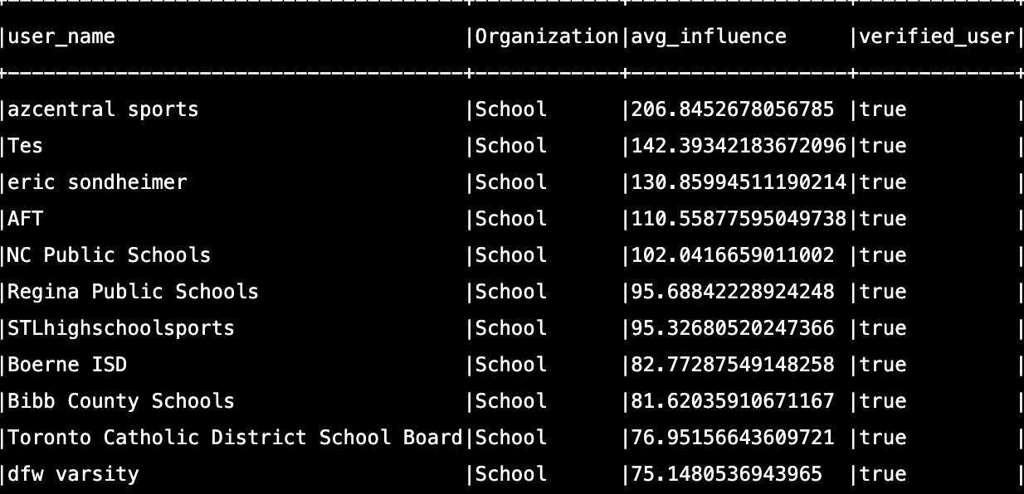
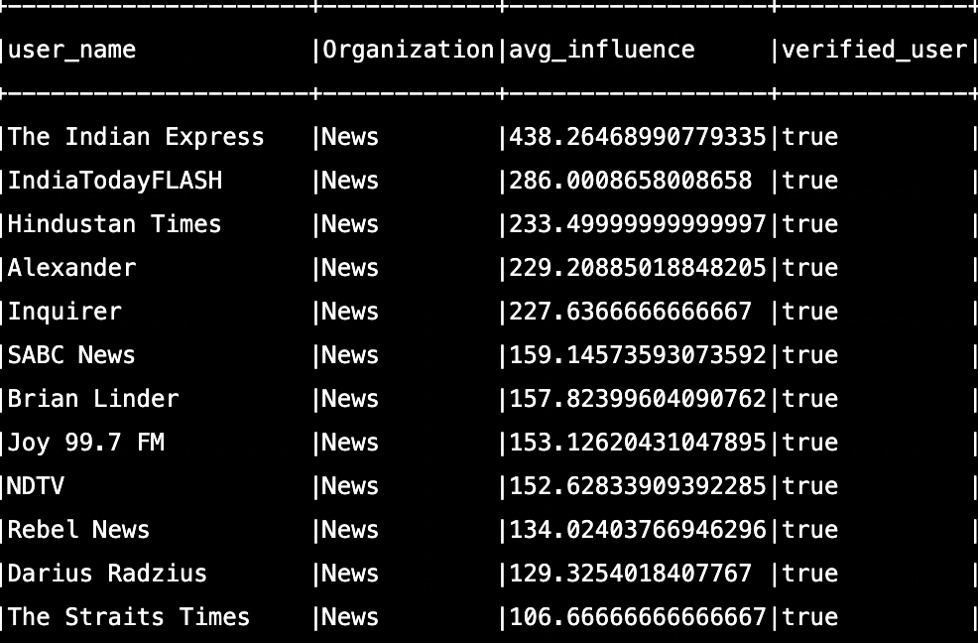
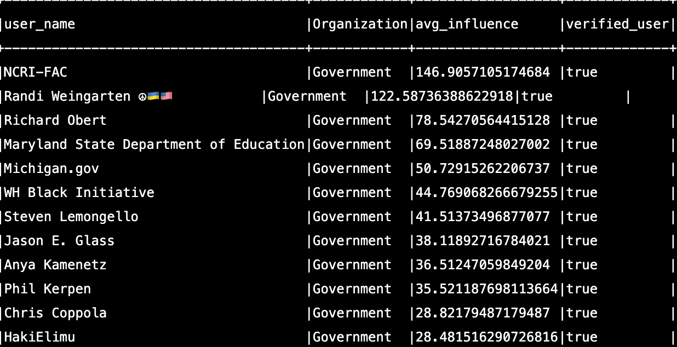
School
Top Twitterers by Influence Score For Each Organization
Top news twitterers are from the highest tweeting countries.
Tes is an award-winning school news magazine.
NCRI-Fac is National council of resistance of Iran.
News
Government

Slide 9
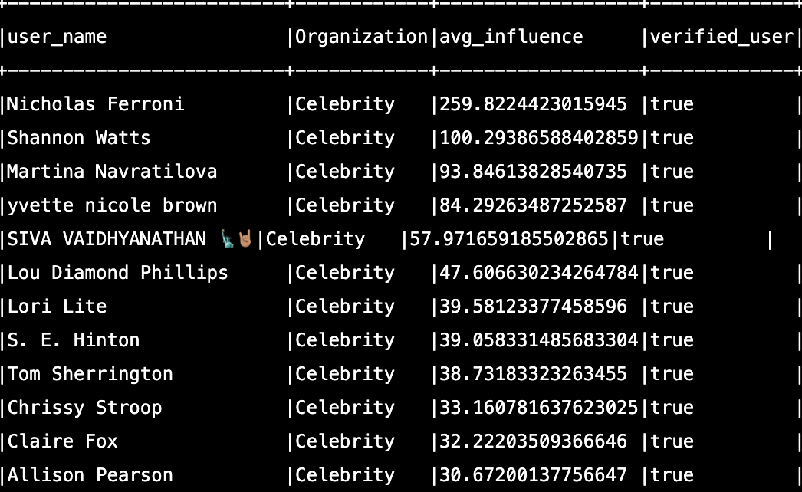
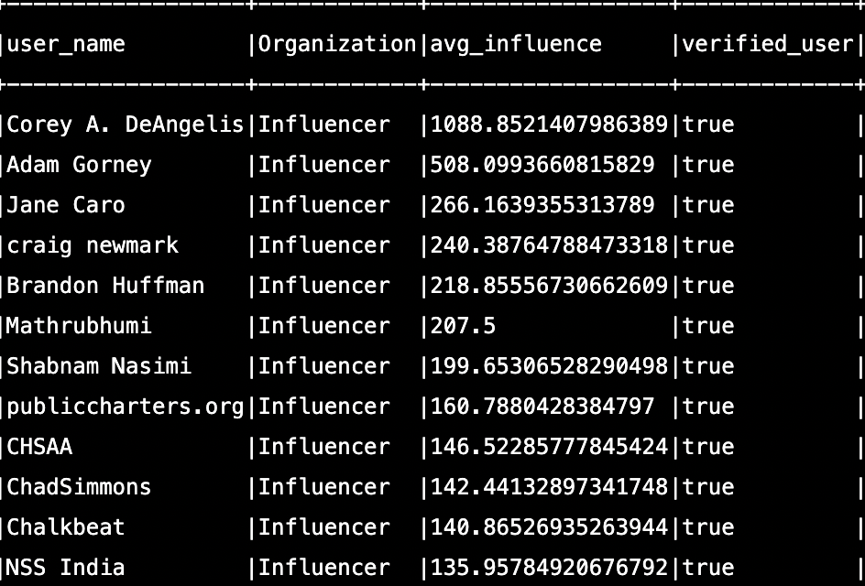
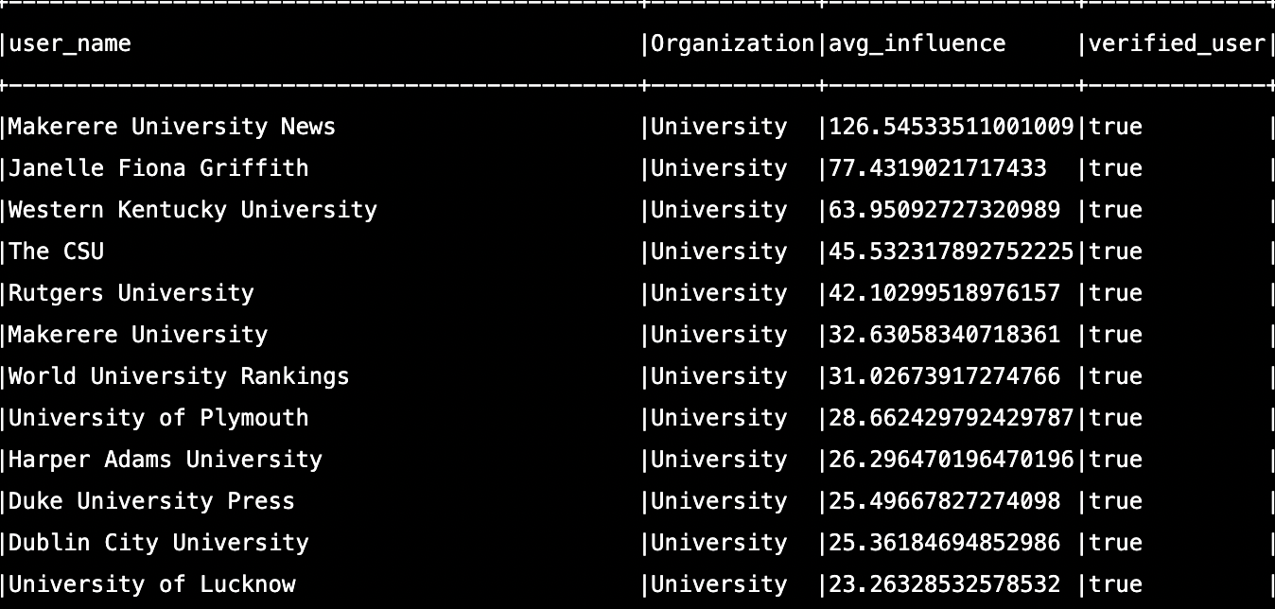
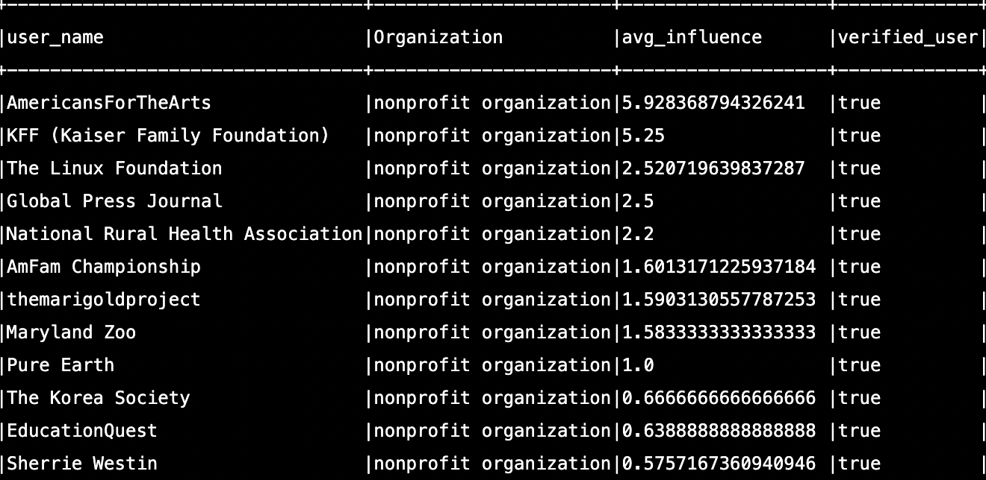
Celebrity
Top Twitterers by Influence Score For Each Organization
Influencer
Corey A DeAngelis is a senior fellow at schoolchoicenow and has 120.6k followers
Nicholas Ferroni is a famous teacher who tweets a lot about education
University
Nonprofit organization
AmericansForTheArts is a non-profit organization which advances arts and education advocacy in US.
Makerere University is one of the biggest universities in Africa

Slide 10
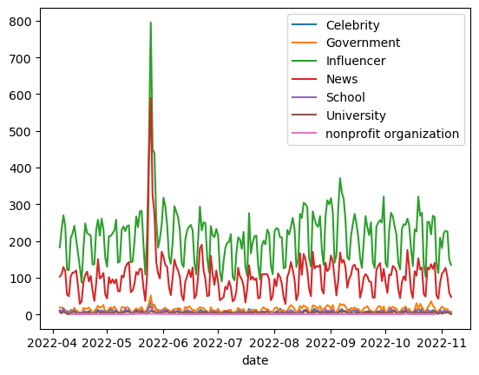
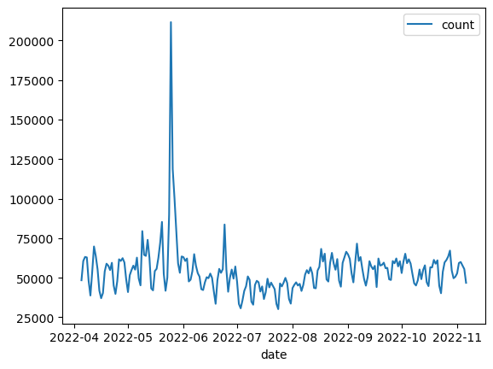
A Look at Tweets Over Time
Month wise count of tweets by organization show a sudden spike during the months may to June , this might be because of the conference World Congress on Education held in June and is a worldwide event discussing educational trends.
News and Influencers are the highest tweeting organization.
Fig 1: Distribution of tweets over time for organizations
Fig 2: Distribution of total tweets over time

Slide 11
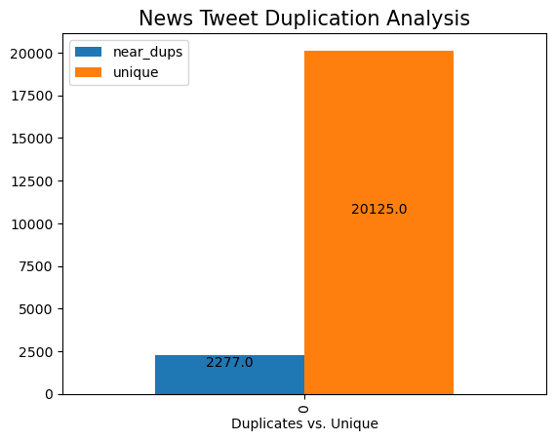
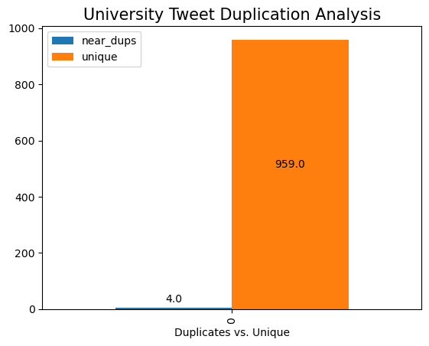
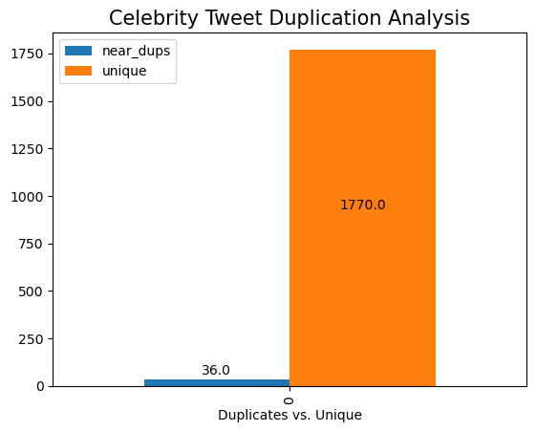
Original Content Similarity Analysis
All organizations/types had a higher percentage of unique tweets which verified that this is original content.
News tweets had higher duplicates; this might be because lot of news channels provide the same information.
University and celebrity tweets had very low duplication.

Slide 12
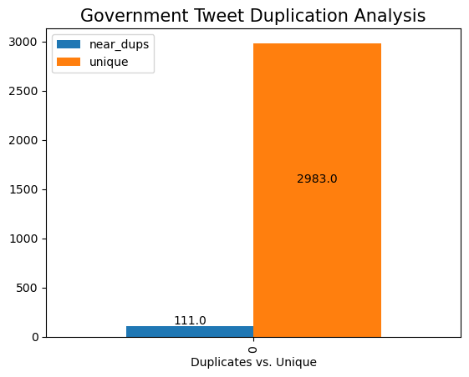
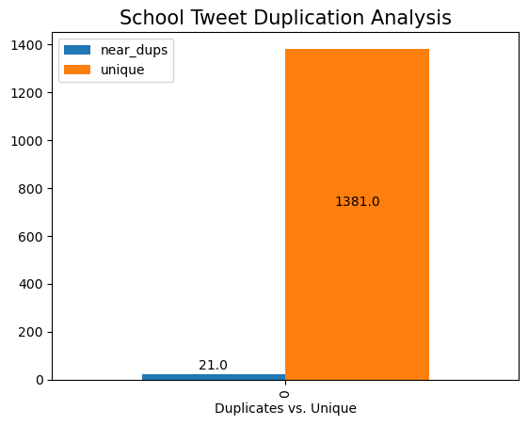
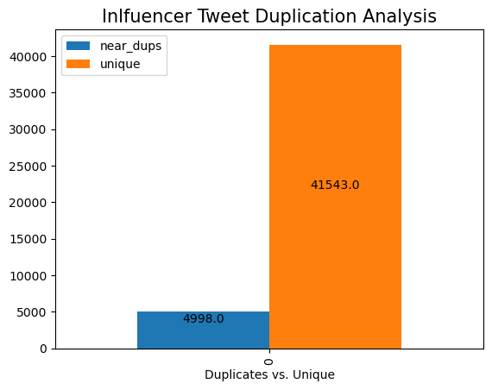
Original Content Similarity Analysis
Influencer tweets also have high duplicates ; this tells us that be because lot of influencers provide the same information.
Governments are local and this aligns that they have low duplication since the information they give might be specific to area. Schools also show very low duplication.

Slide 13
Conclusions and Recommendations
Conclusions:
The majority of twitterers are non-verified and don’t belong to a credible organization. Even top twitterers by original tweet count and retweet count are made up of this group of users.
By organization, “News” and “Influencers” have a big impact as their content is retweeted the most.
Using Average Influence Score within each organization is a reliable way to find the most influential and credible twitterers regarding education trends.
Similarity analysis shows duplicate content is not an indicator of unreliable information, but rather could be a sign that credible twitterers are sharing similar content.
Recommendations:
Twitter should de-prioritize non-verified users that don’t belong to a credible organization within the Twitter algorithm.
Twitter should use an influence score combined with whether the user is a credible source based on their profile information and prioritize their tweets within the algorithm.
Twitter could add badges to tweets from authors identified as credible educational Twitterers.
While tweets are not a good indicator of cases worldwide, having education trending tweets by country could be something to analyze and a potential indicator at a more local- level.
Twitter should not use similarity analysis as a means of determining if a tweet is credible since many credible organizations could share similar information.

Slide 14
Appendix
Methodology Details:
Filtered tweets based on words like Education, university, school, degree, book, public school, higher education, science, math, online learning, Secondary education, k12,curriculum, stem, textbook, science of learning, online learning, ai-driven learning, education trends, education platforms, homeschooling, hybrid-learning, k-12 cybersecurity, asynchronous learning, augmented & virtual reality in the classroom, social-emotional learning, game-based learning
Influence Score:
• Where tweets were original (retweeted_status = Null), influence score was multiplied by a factor of 3.
• Influential twitterers (Top 50%) were anyone with an average influence score above the median average score (0.2017167381974249).
Organizations
• Looked for users based on names and descriptions with terms related to school, government, news, university, nonprofit organization.
• Used terms related to sports, acting, music and where follower count was above 30,000 for celebrity twitterers.
• For general social media influencers, used twitterers where follower count was above 10,000.
• Everyone else and non-verified twitterers went into the “Other” category.
Location Analysis
• For all tweets, visualized location of tweets by their coordinates.
• For tweet counts by top countries, the country variable was used. Every tweet does not have an assigned country, but the top counts are representative of the the top countries with the most twitterers (Statista) so the trend makes sense, but the counts are lower.
• Analyzed the Top 50% of influential twitterers by original tweet count, retweet count, organization and influence score.
• Time Series Analysis was conducted on all tweets by total count and by organization counts.
• Similarity Analysis was conducted on original content by organization.

